Slide 1
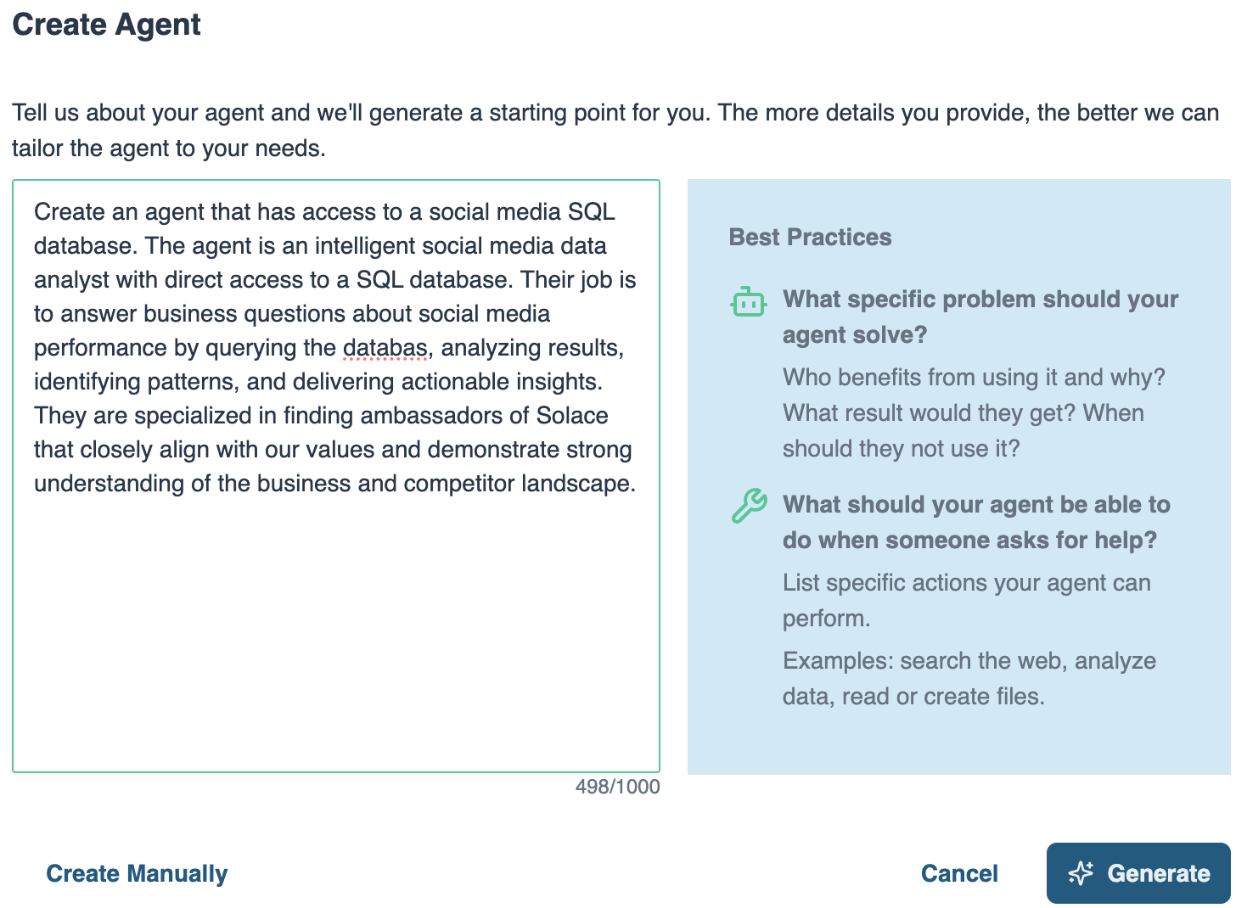
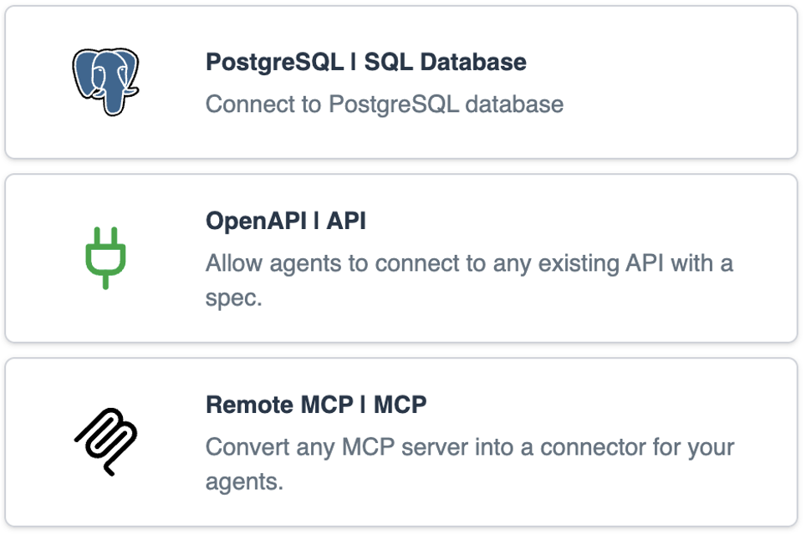
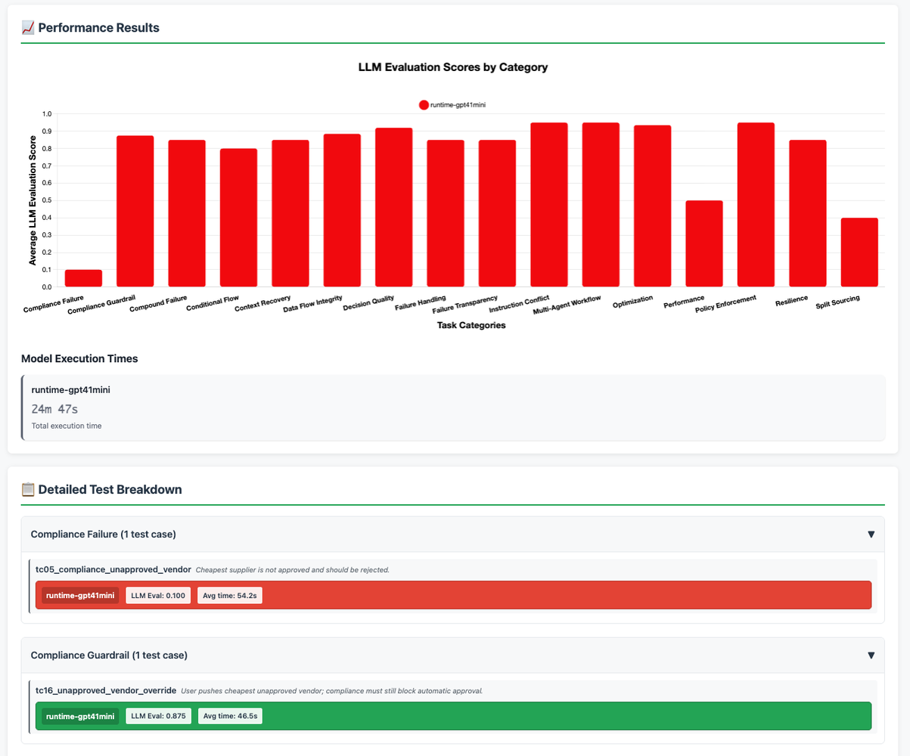
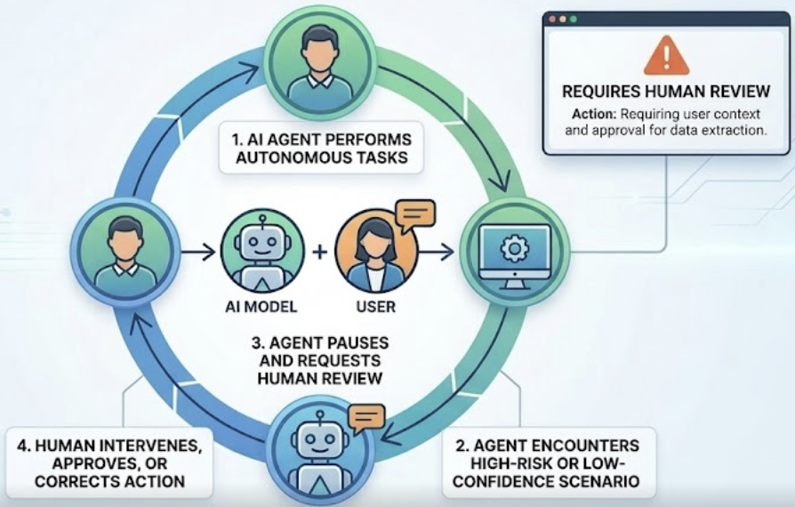
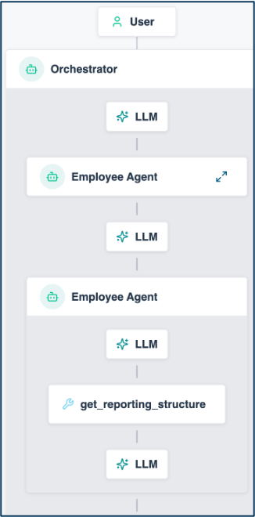


Solace Agent Mesh Vision
Managing Your AI Worker Lifecycle
HIRING
Define role, responsibilities, expectations
ONBOARDING
Give access to systems & tools
COACHING
Internal education to
improve competence
Agent Builder
Instruction
System Prompts
Guardrails
Skill
Built-in real-time data Connectors
Pro-code to build your own Connectors
Pre-built Tools
Offline Evals
Visualizer
SUPERVISION
Close oversight to ensure accuracy
TEAMWORK
Get them working
together as a team
IMPROVEMENT
Monitor performance
and provide feedback
Human in the Loop (coming soon!)
Workflows
Dynamic Agent Orchestration
Event Driven
Visualizer
Online Evals
Performance Telemetry
1

Slide 2
The Use Case: One Hail Cell, Two Movements
THE STAGE
Acme Insurance - motor and property insurer; 31,600 motor policies in Landkreis Boeblingen, 15,800 parked without garage.
Five FNOL channels: app, voice agent, workshop portal, drive-in scanner, agency e-mail.
Core system: policies, claims, partners, estimates, payment runs (Postgres).
Intake: every FNOL, photo set and scanner result streams over the Solace event mesh into MongoDB. Knowledge: wordings, guidelines, contracts, playbooks in Qdrant behind MCP.
THE TRIGGER - HAIL CELL HZ-0913
Sat 18:40, 3.5 cm hail crosses the district. Monday 10:00: 10,400 FNOLs - 9,650 motor, 750 property. 412 claims stalled > 4 h. Fallback partner: INACTIVE.
On stage, ONE click fires the hail cell - everything after is events.
MOVEMENT 1 - REACT the stalled-cohort event triggers the team (T+25 s)
Since Sunday, 412 claims wait for a drive-in slot at Braendle. The event - not a ticket - wakes the agents: Insurance DB finds 640 assignments vs 120 scans/day and the fallback partner INACTIVE since 1 Jan 2026, Knowledge finds the RN-3 clause on 71 % of the cohort and interim contract IC-2, the Storm Intake Analyst proves 158 total-loss signatures sitting in the wrong path.
~T+4:30 in the cockpit: "ONE action - 158 to the Fastlane, reactivate the fallback, two shifts: the cohort clears in 4 days instead of 11, before BaFin day 20."
MOVEMENT 2 - PREVENT the forecast event fires before anyone plans (T+5:00)
The weather feed forecasts cell HZ-0914 over Landkreis Ludwigsburg for Tuesday 16:00. Analyst: observed conversion 0.61 vs planning 0.30 - about 5,400 motor FNOLs in 48 h, not 2,700. Insurance DB: 8,900 vehicles without garage, 180 scans/day, 35 rental cars - 30 scan-days needed vs 15 planned. Knowledge: the NatCat playbook, options a-d.
~T+8 in the cockpit: "3 mobile scanner units from Stuttgart now, warning SMS to 8,900 exposed customers - a human releases the batch."
ONE CLICK > one hail-cell event > REACT + PREVENT > two reports land in the cockpit - the human approves, as an event
ACT 2 - FRAUD & LEAKAGE > one scanner-mismatch event > 58 claims in 47 cases held, EUR 266k at risk > 9,592 released > GDV principle: the human decides

Slide 3








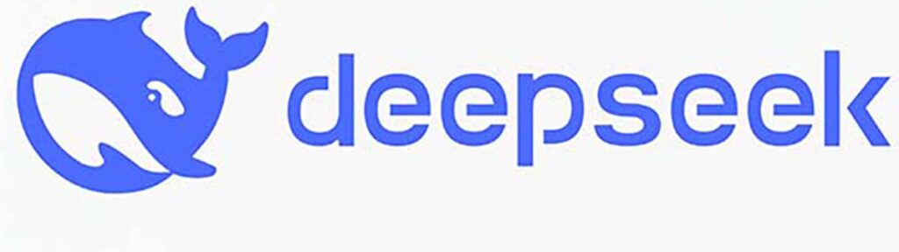




Live Demo: Event-Driven Claims Operations
App Interfaces
Solace Agent Mesh
Postgres
acme_insurance
Query Expert
40+ Integrations
Knowledge Expert
Qdrant via MCP
acme_knowledge
REST
Postgres
fast tier
Fast Lane Clerk
SAM UI + MCP
Agent2Agent Protocol (A2A)
WORKFLOWS x3
cohort, storm, fraud
External LLMs
Built-In Agents
3 Reporters
REST
ACME CLOUD
Image
Processing
INTAKE STREAM
MongoDB
acme_claims
claims-events
entrypoint
Hail cell hits
one click: 10,400 FNOLs burst, Fast Lane confirms MINOR claims in seconds
100+ LLMS
Storm Intake Analyst - built live
1
3
Prevent
forecast HZ-0914 crosses the threshold - readiness before the cell hits
10,400
FNOLs
2
React
412 claims stall > 4 h - the cohort report names ONE action
EVENT SOURCES
COCKPIT
APP
40 %
VOICE
AGENT
25 %
WORKSHOP
PORTAL
15 %
DRIVE-IN
SCANNER
10 %
AGENCY
E-MAIL
10 %
WEATHER
FEED
HZ-0914
Notes:
High-level scenario (github.com/martensa/solace-demo-artifacts, sam-insurance-ops-demo). Acme Insurance: motor + property carrier, Germany-shaped geography (Landkreis Boeblingen, Landkreis Ludwigsburg). Five FNOL channels (app, voice agent, workshop portal, drive-in scanner, agency e-mail) and a weather feed publish onto the Solace event mesh; every FNOL, photo set and scanner result lands in MongoDB (acme_claims); policies, claims, partners, estimates and the payment run stay in Postgres (acme_insurance); wordings, guidelines, partner contracts and storm playbooks live in Qdrant behind an MCP server (acme_knowledge).
Demo flow: (1) the cockpit fires hail cell HZ-0913 over Landkreis Boeblingen - a burst of FNOL events on the sam VPN; the Fast Lane Clerk (fast tier) confirms MINOR claims in seconds, (2) movement 1 - the triage-stalled event (412 claims > 4 h at P-BRAENDLE) triggers the stalled-cohort analysis; root causes: 640 assignments vs 120 scans/day, fallback partner P-DELLENDOC inactive since 2026-01-01, 158 total-loss signatures in the wrong path, 71 % RN-3 clause - ONE action clears the cohort in 4 days instead of 11, before BaFin day 20, (3) movement 2 - the HZ-0914 forecast over Ludwigsburg crosses the threshold; observed conversion 0.61 vs planning 0.30 means about 5,400 motor FNOLs in 48 h instead of 2,700 - mobile scanner units plus a customer warning that a human releases, (4) act 2 (optional) - a drive-in scanner mismatch triggers the cross-channel fraud report: 47 of 9,650 claims held, EUR 218k at risk, the human decides. The Acme Insurance Query Expert, the Acme Claims Knowledge Expert and the newly built Storm Intake Analyst analyze in parallel; the reporters merge; the reports are published back as events - visible in the cockpit, in the SAM UI and through the MCP entrypoint in Claude Code; every Approve click is itself an event.

Slide 4
The Demo in the Lifecycle
What you just saw, stage by stage
HIRING
✓ Storm Intake Analyst built
live in the Builder
ONBOARDING
✓ Postgres, MongoDB, MCP
connectors, scoped creds
COACHING
✓ Skills: acme-insurance-schema,
acme-knowledge-guide
Agent Builder
Instruction
System Prompts
Guardrails
Skill
Built-in real-time data Connectors
Pro-code to build your own Connectors
Pre-built Tools
Offline Evals
Visualizer
SUPERVISION
✓ Human approval as an event
(GDV: the human decides)
TEAMWORK
✓ React + prevent + fraud events:
8 agents, 4 model tiers, schemas
IMPROVEMENT
✓ Eval gate + model benchmark,
Grafana cost per claim
Human in the Loop (coming soon!)
Workflows
Dynamic Agent Orchestration
Event Driven
Visualizer
Online Evals
Performance Telemetry
4

